Slide 1
Indexing

Slide 2
What is Indexing?
INDEXING is a data structure technique which allows you to quickly retrieve records from a database file. An Index is a small table having only two columns. The first column comprises a copy of the primary or candidate key of a table. Its second column contains a set of pointers for holding the address of the disk block where that specific key value stored.

Slide 3
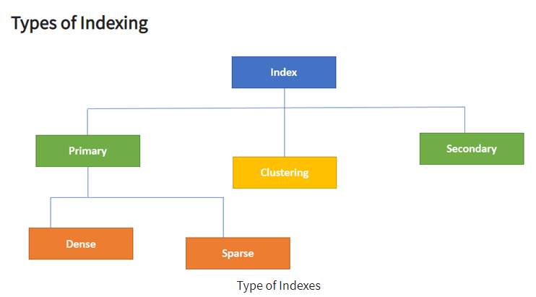

Slide 4
Primary Indexing
Primary Index is an ordered file which is fixed length size with two fields. The first field is the same a primary key and second field is pointed to that specific data block. In the primary Index, there is always one to one relationship between the entries in the index table.

Slide 5
Dense Index
In a dense index, a record is created for every search key valued in the database. This helps you to search faster but needs more space to store index records. In this Indexing, method records contain search key value and points to the real record on the disk.

Slide 6
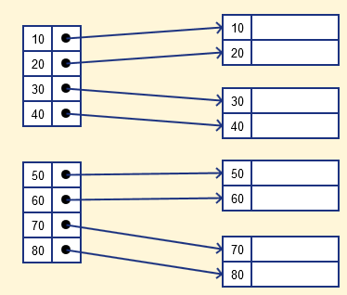

Slide 7
Sparse Index
It is an index record that appears for only some of the values in the file. Sparse Index helps you to resolve the issues of dense Indexing. In this method of indexing technique, a range of index columns stores the same data block address, and when data needs to be retrieved, the block address will be fetched.

Slide 8
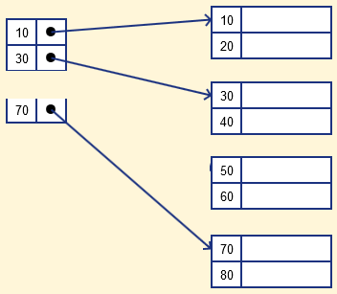

Slide 9
Secondary Index
The secondary Index can be generated by a field which has a unique value for each record, and it should be a candidate key. It is also known as a non-clustering index.

Slide 10
Clustering Index
The Index is created on non-primary key columns which might not be unique for each record. In such a situation, you can group two or more columns to get the unique values and create an index which is called clustered Index. This also helps you to identify the record faster.

Slide 11
Example:
Let's assume that a company recruited many employees in various departments. In this case, clustering indexing should be created for all employees who belong to the same dept.

Slide 12
What is Multilevel Index?
Multilevel Indexing is created when a primary index does not fit in memory. In this type of indexing method, you can reduce the number of disk accesses to short any record and kept on a disk as a sequential file and create a sparse base on that file.

Slide 13
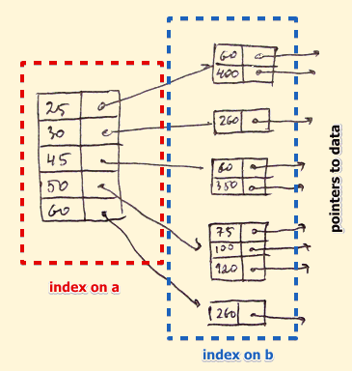

Slide 14
Advantages and Disadvantages of Indexing

Slide 15
Numerical Questions
Suppose that we have an ordered file with r = 30,000 records stored on a disk with block size B = 1024 bytes. File records are of fixed size and are unspanned, with record length R = 100 bytes. And suppose that we have created a primary index on the key field of the file of size 9 bytes and a block pointer of size 6 bytes, then Find the average number of blocks to search for a record using without index and with index ?

Slide 16
Given,
Records = 30000
Block size = 1024 bytes
Record size = 100 bytes
Key + Pointer = 6+ 9 = 15 B (index file record size)

Slide 17
Without indexing
Now, data records that can fit in one block = 1024/100 = 10.24 = 10 (approx.)
Total records = 30000
Therefore,
1 block ------------------------------------> 10 records
10 records --------------------------------> 1 block
30000 records --------------------------> 30000/10 blocks = 3000 blocks
hence, Block Access = ceil ( log 3000 ) = 12 block accesses

Slide 18
With Indexing
Now, data records that can fit in one block = 1024/15 = 68 (approx.)
Total records = 3000
Therefore,
1 block ------------------------------------> 68 records
68 records --------------------------------> 1 block
3000 records --------------------------> 3000/68 blocks = 45 blocks
hence, Block Access = ceil ( log 45) +1 = 7 block accesses

Slide 19
Hashing
In DBMS, hashing is a technique to directly search the location of desired data on the disk without using index structure.
Hashing method is used to index and retrieve items in a database as it is faster to search that specific item using the shorter hashed key instead of using its original value.
Data is stored in the form of data blocks whose address is generated by applying a hash function in the memory location where these records are stored known as a data.

